Slide 1
Detection of Artificial Intelligence Generated Images
Riski Adianto
Saira Faiz
Colby Jamieson
Karl Yazigi

Slide 2
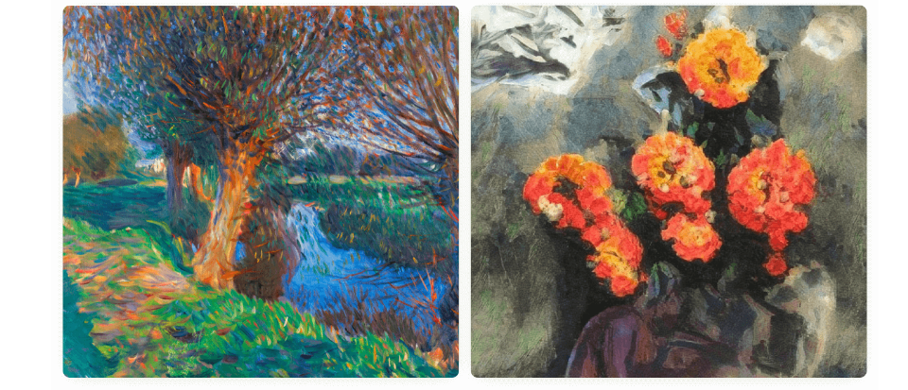
Introduction
What do you think?
Which one is a real painting and which is AI-generated.
A
B
A is a real painting and B is AI-generated
B is a real painting and A is AI-generated

Slide 3
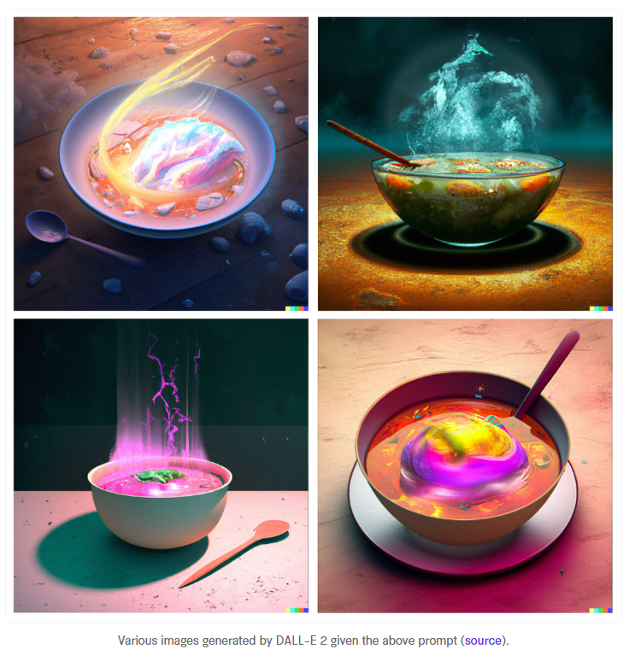
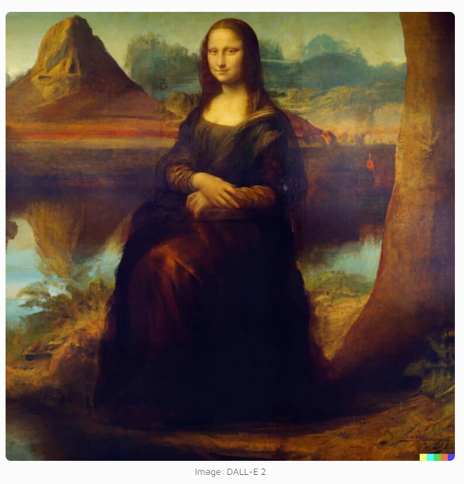
Introduction
What are the capabilities of DALL-E
DALL-E 2 can create photorealistic images based on prompts and textual description.
DALL-E 2 can modify or extend existing images
Edits features such as hairstyle, nose, face, gender
Create background based on textual description

Slide 4
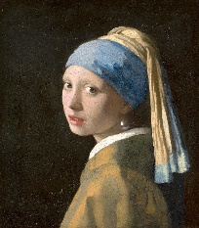
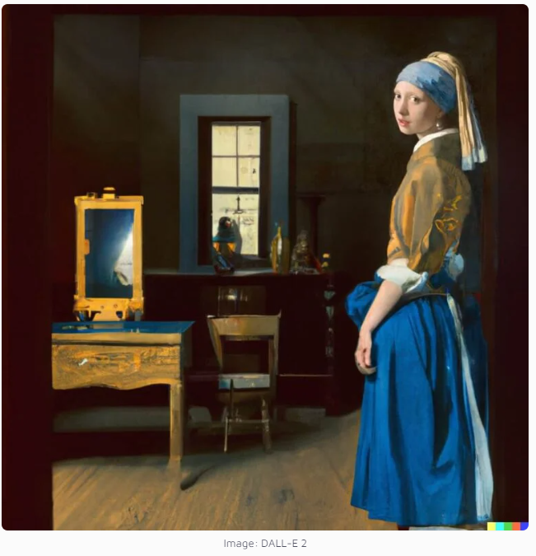
Introduction
Shortcomings of AI generated images
It’s still difficult to draw certain parts of the body, like hands
It can mix different images

Slide 5
Objective & Scope
Whether the model can detect, if the image is AI generated
Automated identity verification, forensics. Deepfake technology
Improve the capabilities of AI
By developing algorithms that can distinguish between images generated by machines and those captured by humans
Robotics, autonomous vehicles, and surveillance systems

Slide 6
Related Work
Sentence:
Sub-sentence

Slide 7
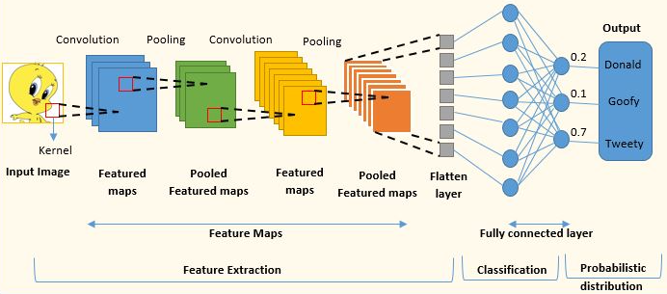
Methodology
Convolutional Neural Network (CNN) was used for the model
Typically used to do image recognition and processing
Designed to process pixel data
CNN utilizes two main operations:
Convolution
Pooling
https://www.analyticsvidhya.com/blog/2022/01/convolutional-neural-network-an-overview/

Slide 8
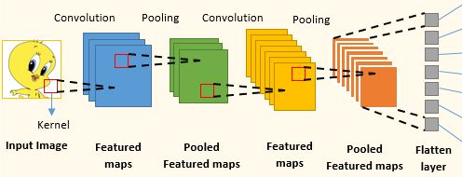
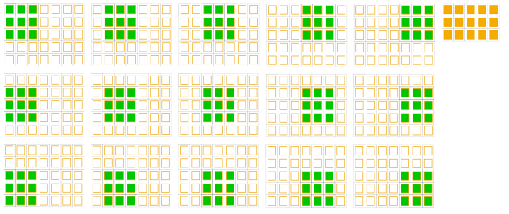
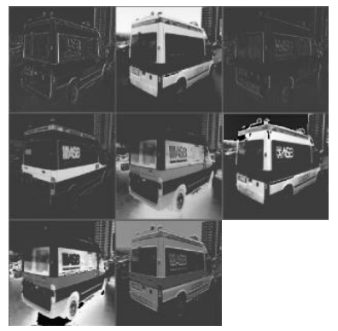
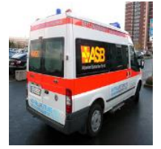
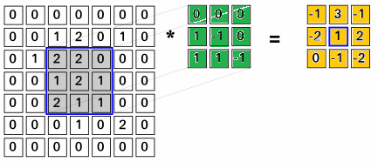
CNN Convolution
Convolution operation:
Use a filter to slide along the input image
Filter → matrix of weights
At each position, take dot product of filter and input pixels
Output: Feature Map
For each convolution hidden layer:
Multiple filters → feature map outputs
Each filter captures specific features of the input
Filter
Input Image Pixels
Feature Map
https://www.uio.no/studier/emner/matnat/ifi/IN5400/v21/lecture-slides/in5400_2021_w5_lecture_convolutions.pdf
https://deepai.org/publication/exploring-linear-relationship-in-feature-map-subspace-for-convnets-compression
https://www.cosmos.esa.int/web/machine-learning-group/convolutional-neural-networks-introduction

Slide 9
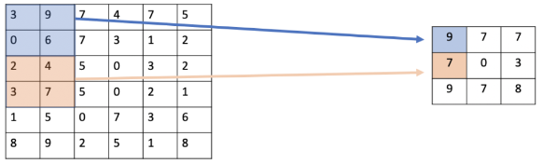

CNN Pooling
Extract important features in feature maps
Recognize features with less dependency to location
Reduce the size of intermediate output
Speed up calculation
Pooling operation:
Use a filter to slide along the feature map
Filter → function to extract important features
Filter examples: max value or average value
Output: condensed Feature Map
Max Pooling
Average Pooling
https://programmathically.com/what-is-pooling-in-a-convolutional-neural-network-cnn-pooling-layers-explained/

Slide 10
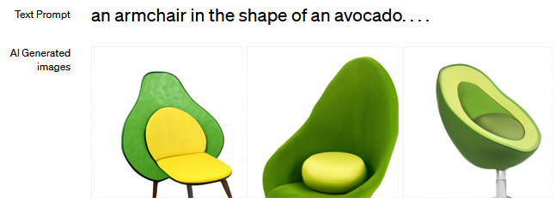
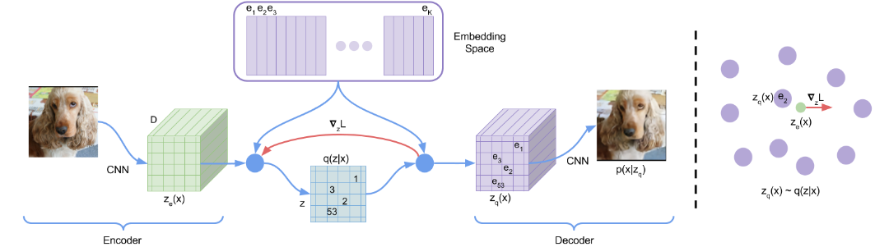
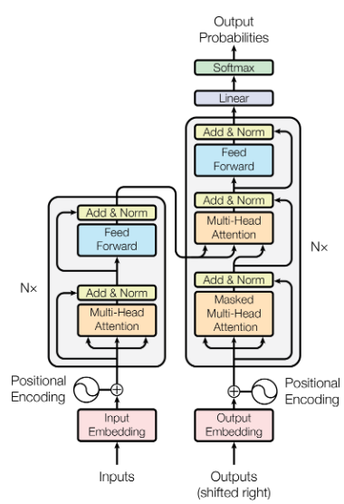
DALL-E
AI image generator developed by OpenAI
Generates images from an input text
Uses a dataset of text-image pairs
Able to combine unrelated concepts in realistic ways
Component 1: VQ-VAE
Generative model
Vector-Quantized Variational Autoencoder
Generates diverse and high-quality distribution of images
https://openai.com/research/dall-e
Van den Oord et al (2017) – Neural Discrete Representation Learning
Component 2: Transformer
Deep learning model
Developed for the GPT models
Learns correlation between texts and images, resulted in creative and accurate outputs
Vaswani et al (2017) – Attention Is All You Need

Slide 11
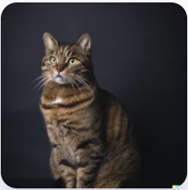
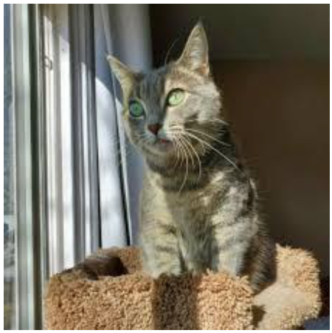
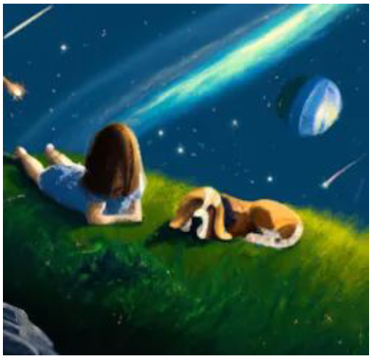
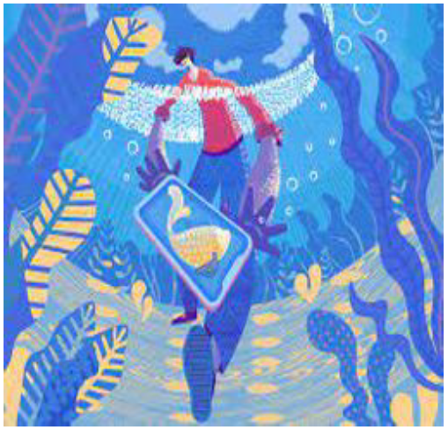
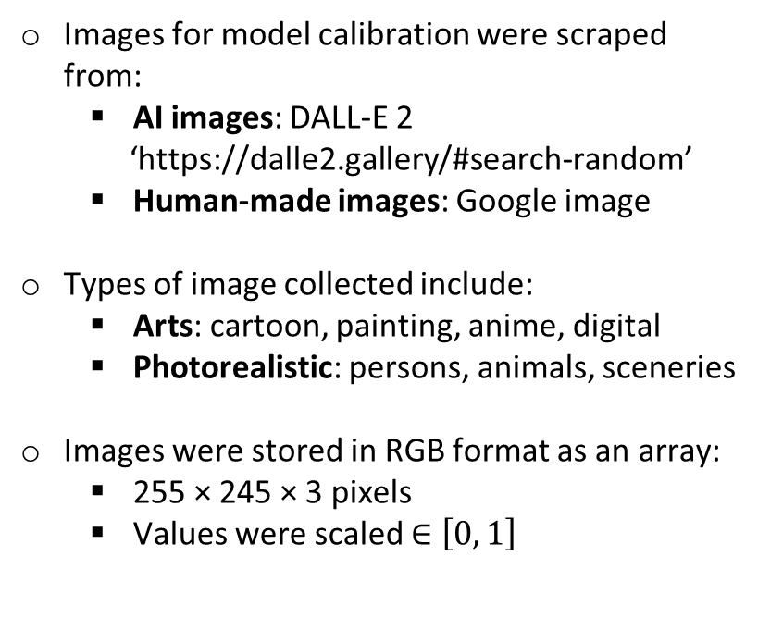
Data Collection
Images for model calibration were scraped from:
AI images: DALL-E 2
‘https://dalle2.gallery/#search-random’
Human-made images: Google image
Types of image collected include:
Arts: cartoon, painting, anime, digital
Photorealistic: persons, animals, sceneries
Images were stored in RGB format as an array:
255 × 245 × 3 pixels
Values were scaled $∈\left[0, 1\right]$
AI
Human
Cat
Painting

Slide 12
Training & Testing
Training is performed for 10 epochs, with each epoch using a different batch of data from 1800 images (split evenly between human and DALLE-2 generated images)
Testing performed on batch of 930 DALLE-2 and 650 human generated images data
“Adam” optimizer is used with a learning rate of 0.00005
Binary cross-entropy loss function is used to calculate the loss during training
Notes:
Model was trained for 10 epochs on 5 batches of 1800 images. So a total of 9000 images were used to train the model split equally between DALL-E generated and Human made images:
Sub-sentence
Test batch was 1580 images 930 of which were dall-e generated and 650 human made:
Sub-sentence

Slide 13
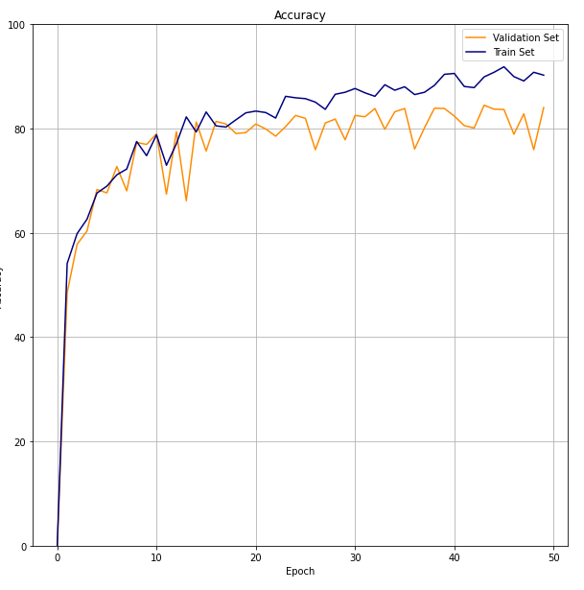
Results: Accuracy
Optimal validation set accuracy ~80% around 20 epochs
Notes:
The 50 epochs on the graph for accuracy are because of the 10 epochs for 5 batches (10x5 = 50):
I’ve made graphs of accuracy, confusion matrix (for fp tp fn and tn rates), and the ROC and AUC curve
Sub-sentence

Slide 14
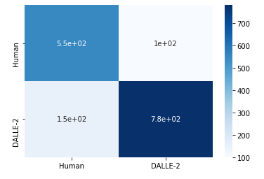
Results: Confusion Matrix
Confusion Matrix
100 incorrectly labeled DALLE-2 images
150 incorrectly labeled human-made images
Predicted
Actual
Notes:
The 50 epochs on the graph for accuracy are because of the 10 epochs for 5 batches (10x5 = 50):
I’ve made graphs of accuracy, confusion matrix (for fp tp fn and tn rates), and the ROC and AUC curve
Sub-sentence

Slide 15
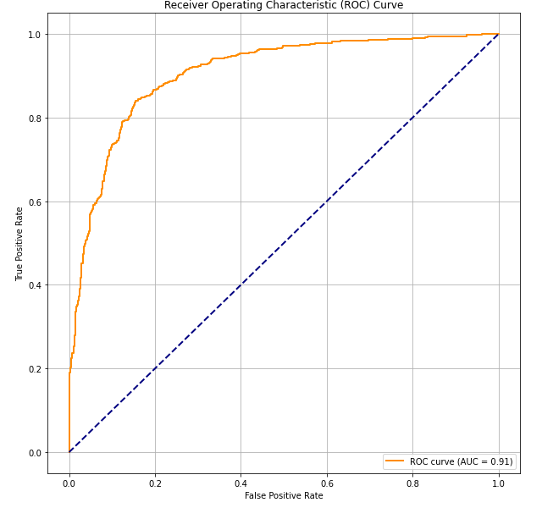
Results: Confusion Matrix
Area under curve: 0.91
High performing sensitivity and specificity trade-off
Relatively high true positive and low false positive rate
Notes:
The 50 epochs on the graph for accuracy are because of the 10 epochs for 5 batches (10x5 = 50):
I’ve made graphs of accuracy, confusion matrix (for fp tp fn and tn rates), and the ROC and AUC curve
Sub-sentence

Slide 16
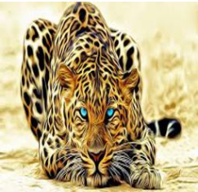
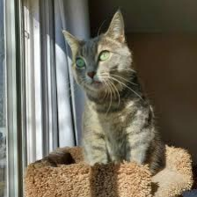
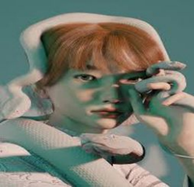
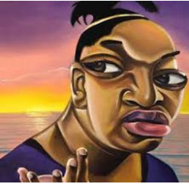
Results: Human Art
Prediction: human (0.00014)
Prediction: human (0.11)
Prediction: DALLE (0.84)
Prediction: DALLE (0.60)

Slide 17
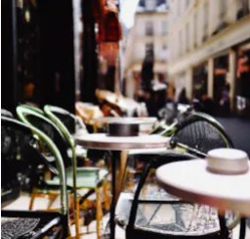
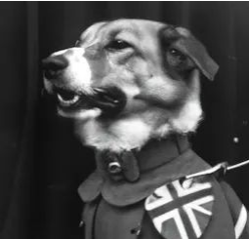

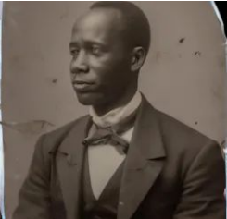
Results: DALLE Art
Prediction: DALLE (0.997)
Prediction: DALLE (0.89)
Prediction: human (0.19)
Prediction: human (0.42)

Slide 18
Discussion
Ideas:
Scalability
Limitations
Future work
Importance of work and usage

Slide 19
Summary
Sentence:
Sub-sentence

Slide 20

Thank You

